Slide 1
Guided Capstone

Slide 2
Problem Identification
Big Mountain Resort is a ski resort that has an increased $1.5 million from additional operational costs
Goal will be to have a new ticket price using data that maximizes profit by the end of the fiscal year 2022
Must look at different costs of other ski resorts as an example
Constraints:
Time: Limited time frame to find new price
Features: Resorts might have different prices based on features that are not accounted for
Important Stakeholders: Jimmy Blackburn and Alesha Eisen

Slide 3
Recommendation and Key Findings
Big Mountain Resort has:
Geographical advantage
Competitive price, and is positioned in the premium segment of the market
Upgrading the facility to charge a higher price while attracting more visitors would increase the resort’s competitive advantage
Recommendations:
Increase price by $2, from $81 to $83
Adding run 150 ft lower down, and chair lift to support it
Closing one of the least used runs is expected to have no impact to existing revenue

Slide 4
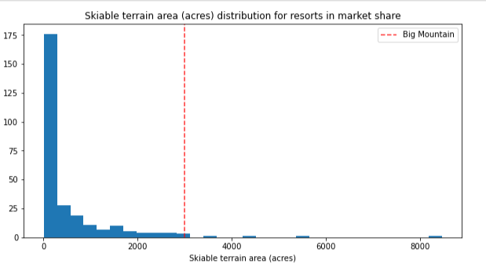
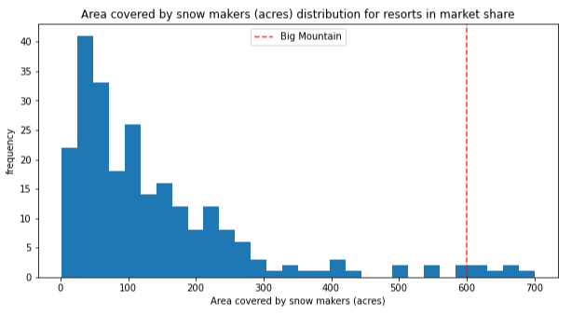
Big Mountain Resort’s Geographical Advantage
Big Mountain is among the resorts with the largest amount of skiable area.
In terms of snow making area, Big Mountain is in the high end.

Slide 5
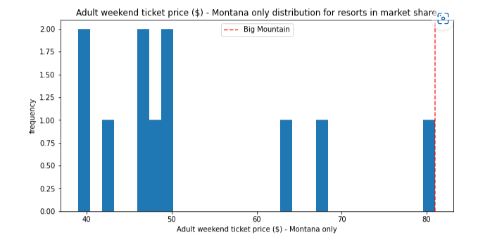
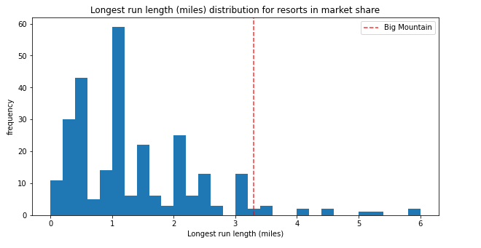
Modeling Results and Analysis
Big Mountain is priced competitively.
Big Mountain has one of the longest runs.

Slide 6
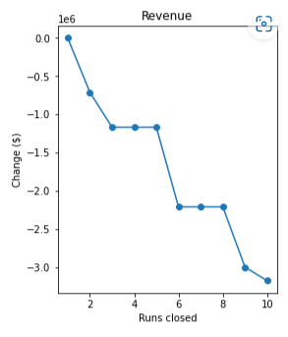
Modeling Results and Analysis
Closing one of the least used runs is expected to have no impact to existing revenue. Closing more runs would have a massive impact.

Slide 7
Summary and Conclusion
Increase price by $2, from $81 to $83
Add a run 150 ft lower down, and chair lift to support it
Since the data has not been provided, these changes do not account for additional capital expenditure and on-going operation
It is assumed that the additional chair lift would increase the operating cost by $1.54 million
Additional consideration to improve model:
Operating cost data
Visitor volume

